Slide 1

KNOWLEDGE DISCOVERY AND DATA MINING
PROJECT 4 MIHIR SAWANT, JANVI KOTHARI, UMESH NAIR

Slide 2


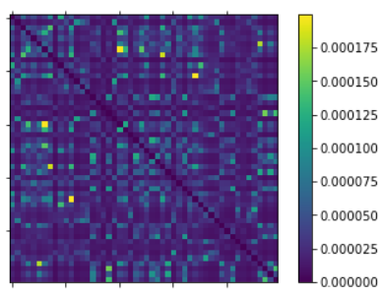
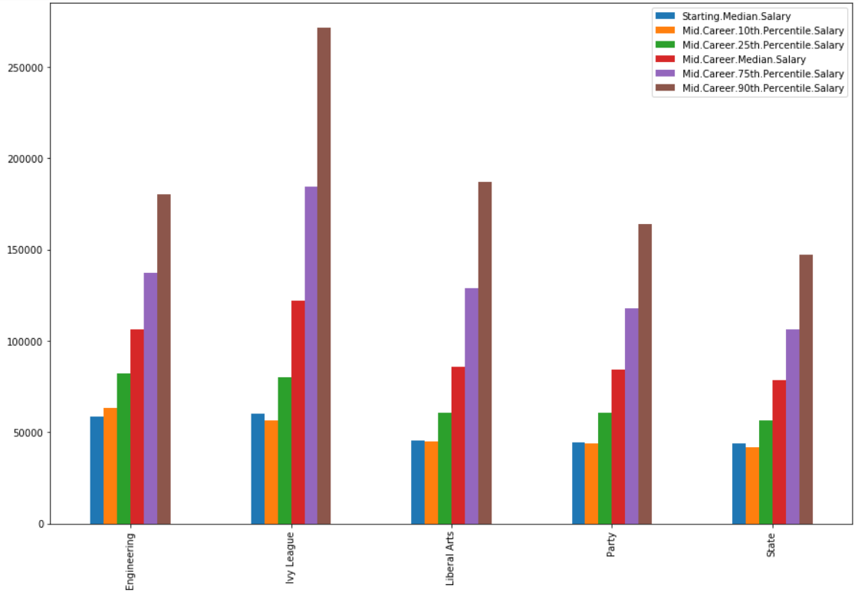
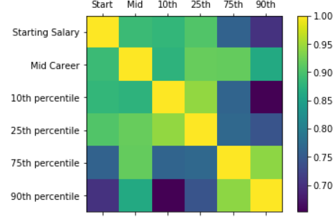
DATA EXPLORATION
degrees-that-pay-back
salaries-by-college-type
salaries-by-region

Slide 3
GUIDING QUESTIONS

Slide 4
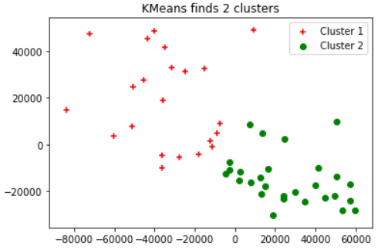
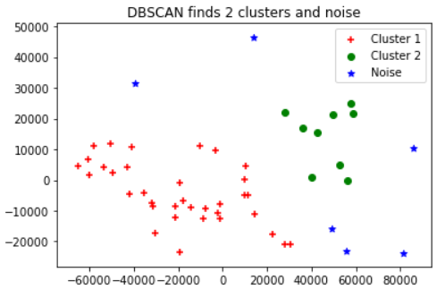
1. WHICH UNDERGRADUATE MAJORS ARE CLUSTERED TOGETHER?
Visualized using MDS. Silhouette Score = 0.5
PCA representation : Smaller cluster consists of Ivy League colleges. Silhouette Score = 0.36 (eps = 20000, min_samples = 5)

Slide 5
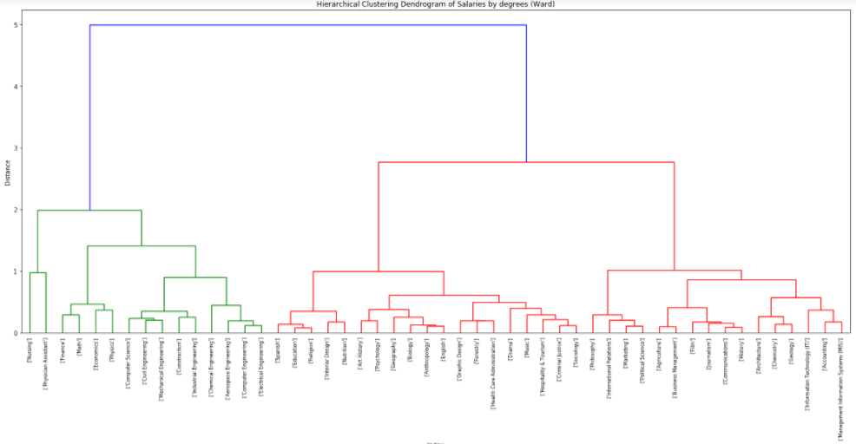
Hierarchical Clustering Dendrogram Using Ward’s Method

Slide 6
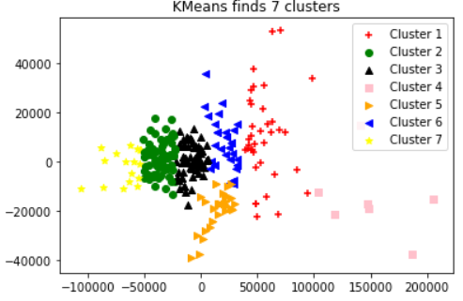
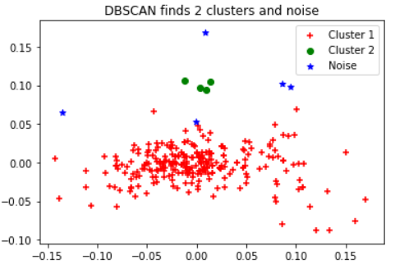
2. WHICH SCHOOL TYPES/NAMES ARE CLUSTERED TOGETHER?
Visualizing 7-means using PCA
Visualizing DBSCAN using PCA on normalized data (eps = 0.05, min_samples = 3)

Slide 7
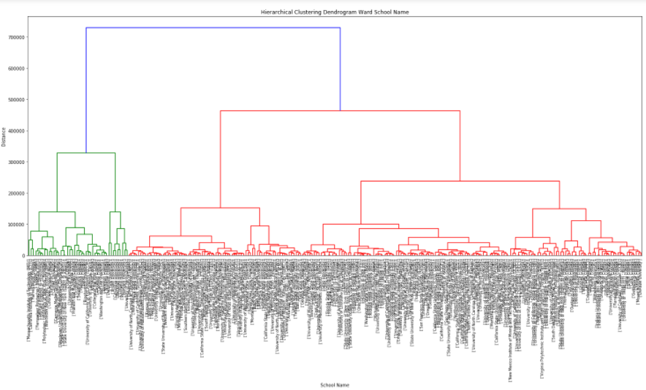
Hierarchical Clustering Dendrogram for School Names using Ward’s method

Slide 8
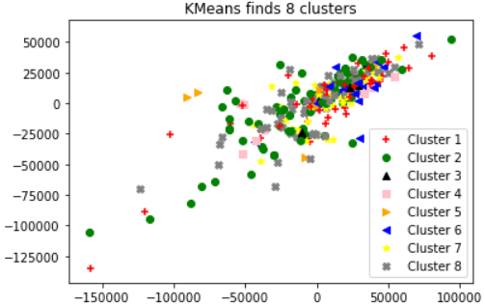
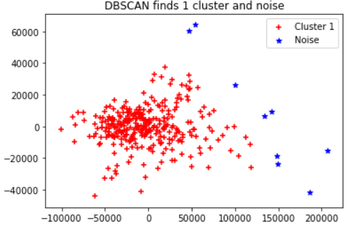
3. WHICH REGIONS ARE CLUSTERED TOGETHER?
8-Means visualized with MDS. Silhouette coeff = 0.22
DBSCAN visualized with PCA. Silhouette coeff = 0.62 (eps = 30000, min_samples = 10)

Slide 9
ADVANCED TOPIC

Slide 10
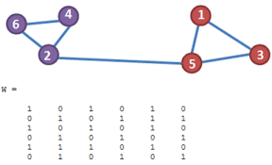
SPECTRAL CLUSTERING
INTRODUCTION:
Extension of K-means
Maps dataset to low dimensional space
PRIMARY UNDERSTANDING :
Creates graph structure of data.
Each node represents a data point.
Nodes connected by edges that have a weight.
Weight is calculated similarity between two data points.

Slide 11
SPECTRAL CLUSTERING ALGORITHM
INPUT: Similarity matrix
The graph is represented as a matrix called Adjacency matrix (W).
Transform this to its Laplacian transform; called Laplacian matrix (L).
This rearranges our graph in a ‘d’ dimensional space.
Compute first k eigenvectors of L .
Store these in a matrix V of eigenvectors.
Each vector y_{i} corresponds to ith row of V.
Cluster points (y_{i} ) _{i} using K-means algorithm.
OUTPUT: Clusters from data

Slide 12
THANK YOU!

